Slide 1
DSIF3
Group 1
Project 2
Brandon
Cheng Kiat
MunYee
Thien Sean
Raymond

Slide 2

Problem Statement
As real estate analysts in Iowa, we are responsible for managing our organization's real estate holdings.
We are tasked with understanding real estate market trends and to minimize current and future real estate holding risks.
We will be conducting data analysis on the Iowa real estate market and determine which are the factors that affects property prices.
The purpose of this analysis is to better understand property prices and provide suitable insights to management and potential buyers of the organization's real estate.
www.G1 propnet.com

Slide 3
Overview :
Purpose Statement
Background & Data
Methodology :
EDA & data cleaning
Feature engineering
Data transformation
Modeling
Conclusion & Recommendation
Q&A

Slide 4
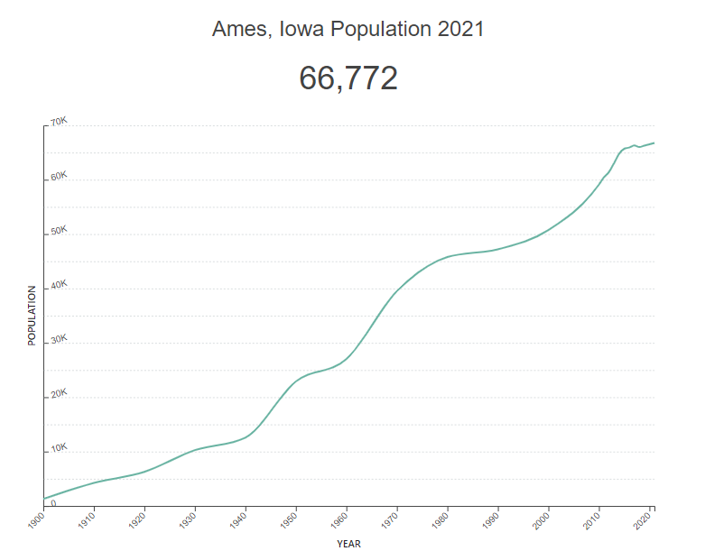


Introduction
Ames, Iowa population have been steadily increasing year to year and this is a great opportunity in the housing sector to help families find the perfect home.
But what makes a property to be high in demand? What features fetch the best pricing during sales closing?
Source: Ames, Iowa Population 2021 (Demographics, Maps, Graphs) (worldpopulationreview.com)

Slide 5
EDA & Data Cleaning

Slide 6
Checking for Missing Values
Divided the missing values into 3 groups (Basement Variables, Garage Variables & Individual Variables)
Variables | Number of Missing Values | Method of Resolving
Pool QC | 2042 | Leave it as NaN since NaN means no pool
Misc Feature | 1986 | Leave it as NaN since NaN means no misc feature
Alley | 1911 | Leave it as NaN since NaN means no alley access
Fence | 1651 | Leave it as NaN since NaN means no fence
Fireplace Qu | 1000 | Leave it as NaN since NaN means no fireplace
Lot Frontage | 330 | Impute 0 to the missing values as missing values in Lot Frontage occurs mainly in residential low density zones which means no lot frontage
Mas Vnr Type | 22 | Assign as None after value_counts showed 60% of the houses have None
Mas Vnr Area | 22 | Assign as 0 since the number of missing values is equal to Mas Vnr Type
Notes:
First we check for missing values. The missing values can be divided into 3 groups(Individual Variables, Basement Variables, Garage Variables) For the first 6 variables, we leave the NaN values as it is as an NaN represents the amenality is not available. For lot frontage, we will impute the value 0 as most of the NaN values occurs in houses in residential low density zones which does not have a Lot Frontage. For Mas Vnr Type, we will impute None as 60% of the house do not have it and the corresponding area to be 0.

Slide 7
Checking for Missing Values (Garage Variables)
Variables | Number of Missing Values
Garage Yr Blt | 114
Garage Cond | 114
Garage Qual | 114
Garage Finish | 114
Garage Type | 113
Garage Cars | 1
Garage Area | 1
The garage type has 1 less missing value as compare to the variables above it thus indicating there is only 1 missing value among the garage variables.
Pulling out the entry tells that the garage type with missing values is detchd.
We then impute the most common values for Detchd garages to fill the NaN.

Slide 8
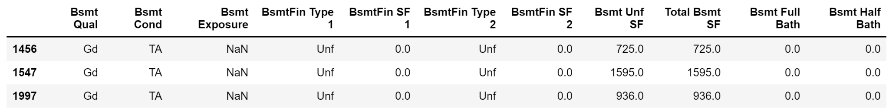
Checking for Missing Values (Basement Variables)
Divided the basement variables into 2.
Categorical - Pink (Slide 8 & 9)
Numeric - Green (Slide 10)
There is 1 more BsmtFin Type 2 and 3 more Bsmt Exposure.
Examining Bsmt Exposure shows the basement were unfinished thus the exposure was not missing.
Imputed No to these 3 missing values as No is the most common occurrence. Basement are normally not exposed unless there is construction.
Variables | Number of Missing Values
Bsmt Exposure | 58
BsmtFin Type 2 | 56
Bsmt Cond | 55
Bsmt Qual | 55
BsmtFin Type1 | 55

Slide 9
Checking for Missing Values (Basement Variables)
Updated table after Bsmt Exposure values are filled.
There is now only 1 more BsmtFin Type 2
Pulling out the entry shows the house has 2 basement and 1 of them is finished while the second is unfinished thus the type is missing.
The missing value is change to Unf which stands for unfinished.
Variables | Number of Missing Values
Bsmt Exposure | 55
BsmtFin Type 2 | 56
Bsmt Cond | 55
Bsmt Qual | 55
BsmtFin Type1 | 55

Slide 10
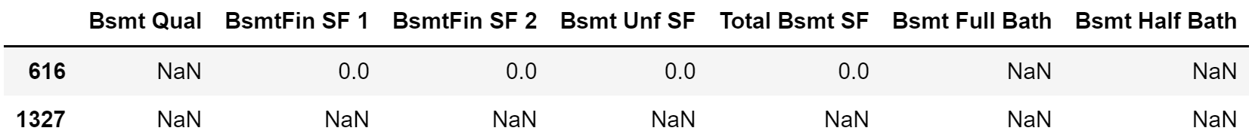
Checking for Missing Values (Basement Variables)
Variables | Number of Missing Values
Bsmt Qual | 55
Bsmt Half Bath | 2
Bsmt Full Bath | 2
Total Bsmt SF | 1
Bsmt Unf SF | 1
Bsmt Unf SF 2 | 1
Bsmt SF 1 | 1
Bringing in a numeric variable (Bsmt Qual) for comparison
Pulling out the data shows both the houses do not have basement.
Impute 0 to all missing values since the house has no basement.

Slide 11
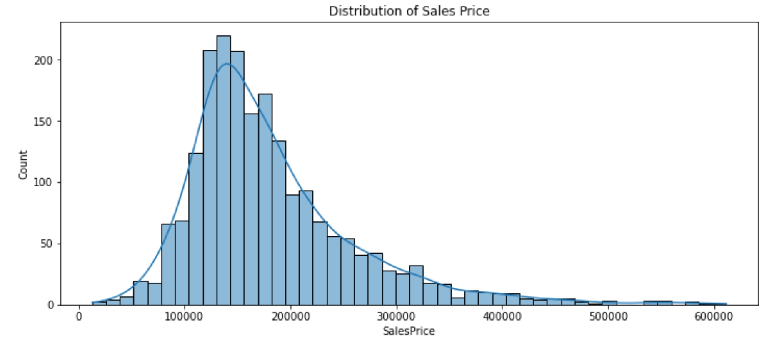
Distribution of Target Variable (SalePrice)
The target variable behaves as a normal distribution with mean about 150,000 and slightly skew to the right.
This indicates that there are some houses which are sold at extremely high prices thus creating this skew.

Slide 12
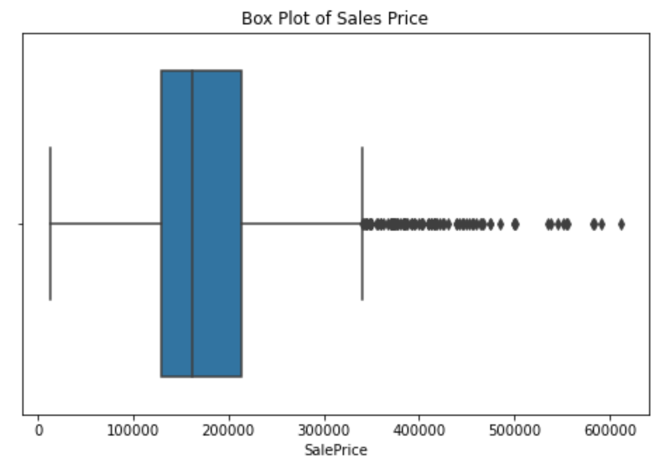
Outliers
Although there are outliers, this does not necessary mean that those data are wrong.
It is just the price of some houses may fetch high prices due to their location, accessibility to facilities and amenities.
Leaving the outliers out will certainly improve the model’s ability to predict prices of houses in the normal range.
However leaving them out will cause the model to fail in predicting prices of houses that fetch high prices.
The assessment matrix selected for this model is rmse and one outlier can cause a huge rise in rmse thus the outliers will be retained to train the model.

Slide 13
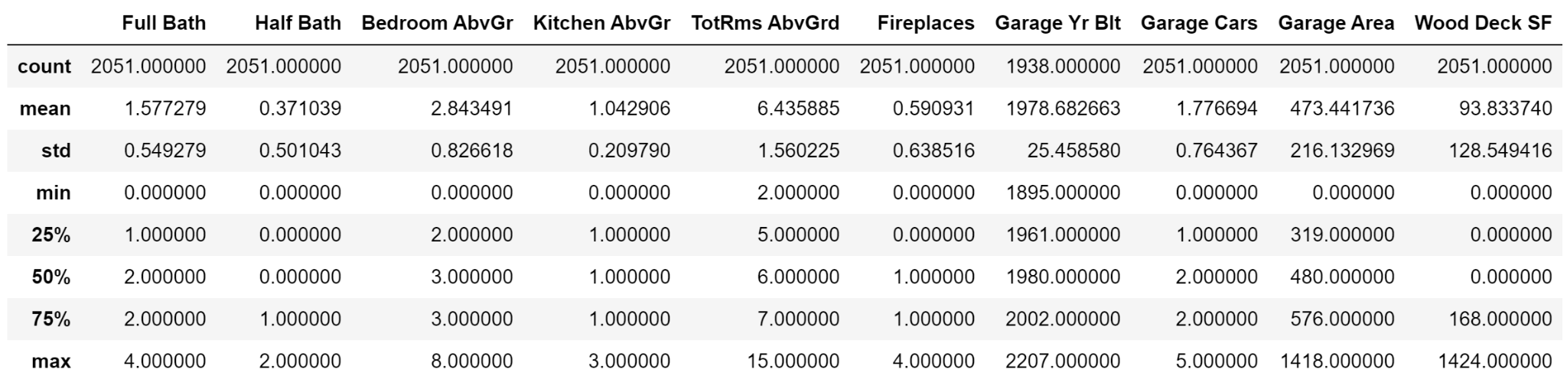
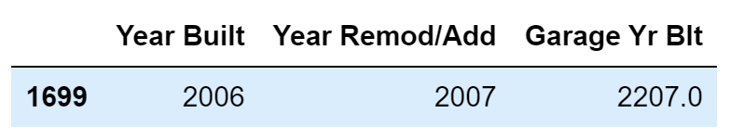
Summary Statistics
Summary Statistics shows an error in the Garage Yr Built.
Checking the max value for year house is built or remodel returns 2010.
Checking the entry reveals that likely is a wrong data entry and imputed the value 2007.

Slide 14
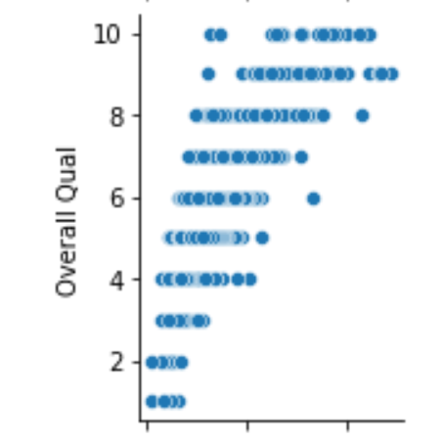
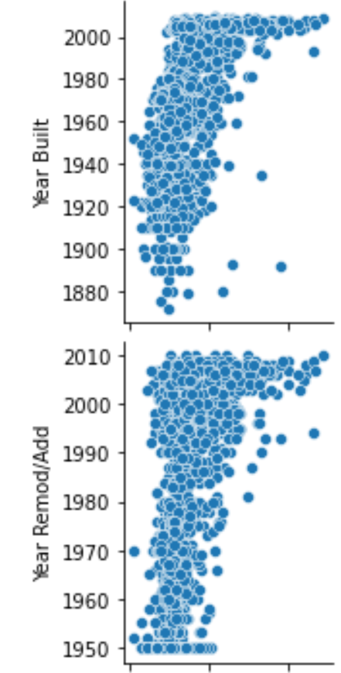
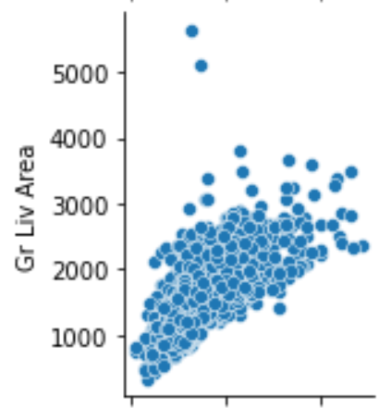
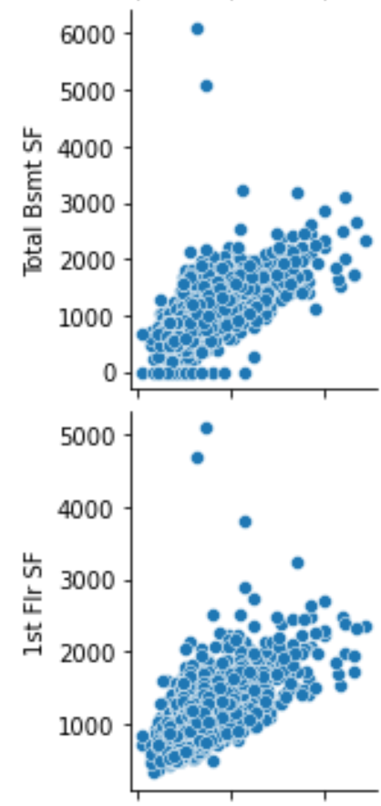
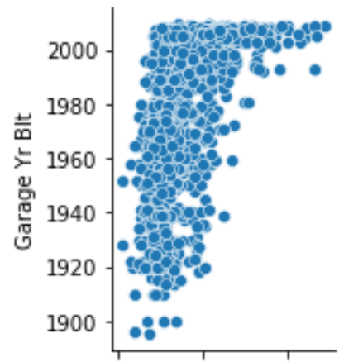
Pairplot for Numeric Variables
Using pairplot to plot numeric variables against SalePrice
Pairplot reveals 7 variables that are linearly related to SalePrice

Slide 15
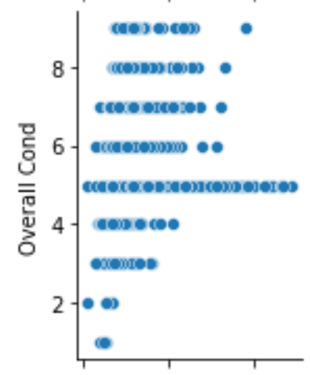
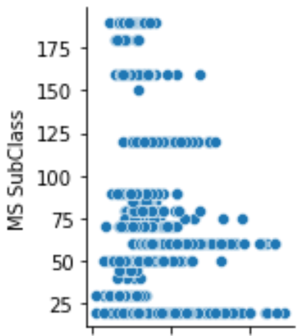
Pairplot for other Variables
2 other variables of interest are overall cond and MS subClass.
Normally the higher the overall condition of the house, the higher will be the SalePrice, however this shows that other factors like location of amenities also play an important part in the SalePrice.
MS SubClass shows 2 particular housing type fetch high SalePrice.

Slide 16
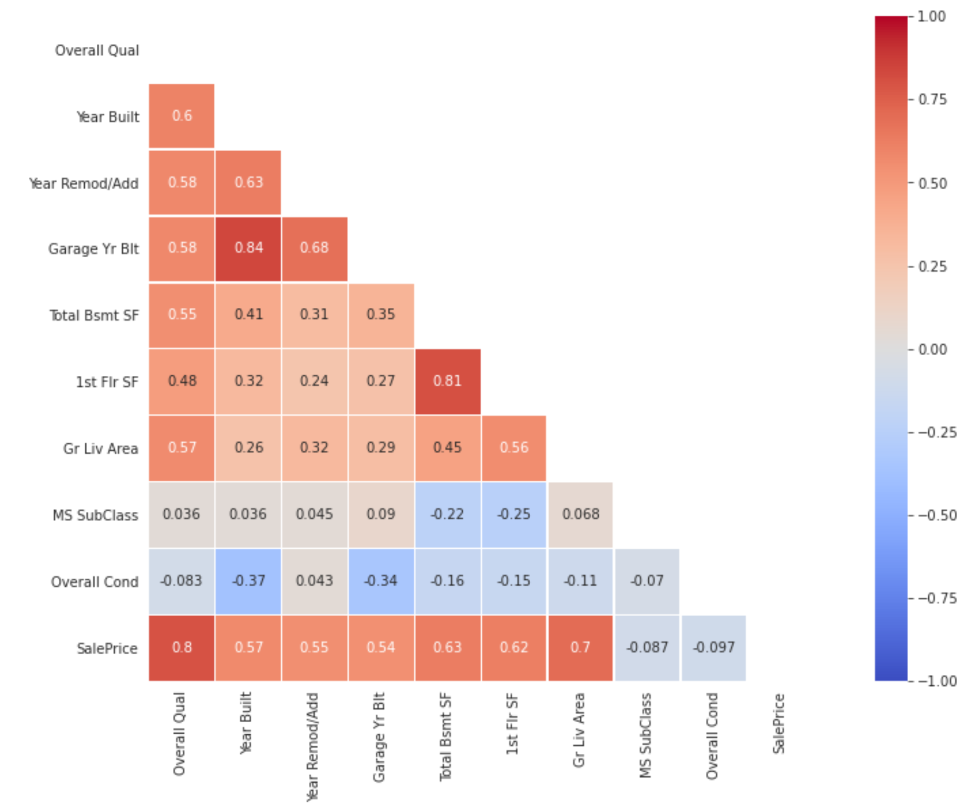
Heat Map
Heat Map shows the variables on slide 14 all has high correlation with SalePrice that is at least higher than 0.5.
The 2 variables in slide 15 however has negative correlation.

Slide 17
Feature
Engineering

Slide 18
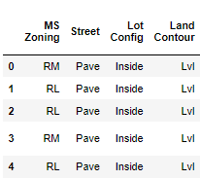
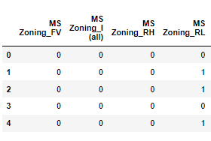
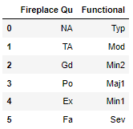
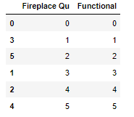
Data processing
Discrete & Nominal Data:
All the categorical data are in string format unable to process.
One hot encode to produce binary output.
Ordinal data:
Note that not all ordinal features have the same scale.
Remap all the data on the same performance scale of 1-to-5.

Slide 19
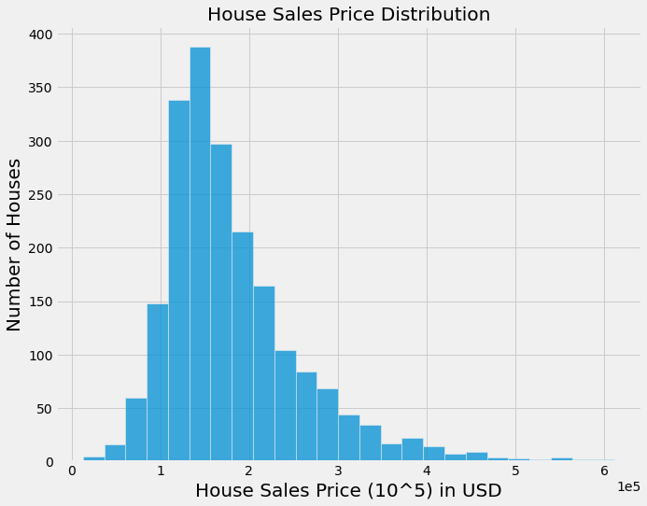
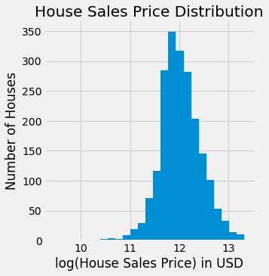
Data processing
Continuous Data:
Imputation was done to resolve the Null values the data in the previous chapter.
Next we will transform the sales price to a logarithm scale to fit it to a normal distribution.

Slide 20
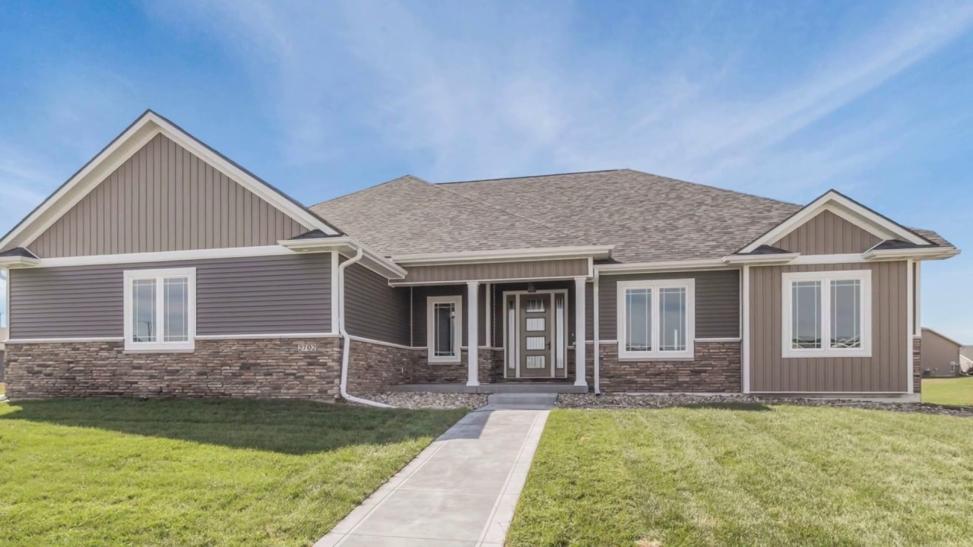
Top features impacting Sales Price in Ames, Iowa
Ranking | Features | Ridge Coefficient
1 | Gr Liv Area | 0.129777
2 | Overall Qual | 0.073051
3 | Year Built | 0.062722
4 | Total Bsmt SF | 0.054044
5 | Year Remodel/Add | 0.041420
6 | Fireplace Qu | 0.039419
7 | Garage Area | 0.037992
8 | Kitchen Qual | 0.031634
Key features that impacts the sales price in Iowa are mainly Ground living area, Overall quality, year built and etc.

Slide 21
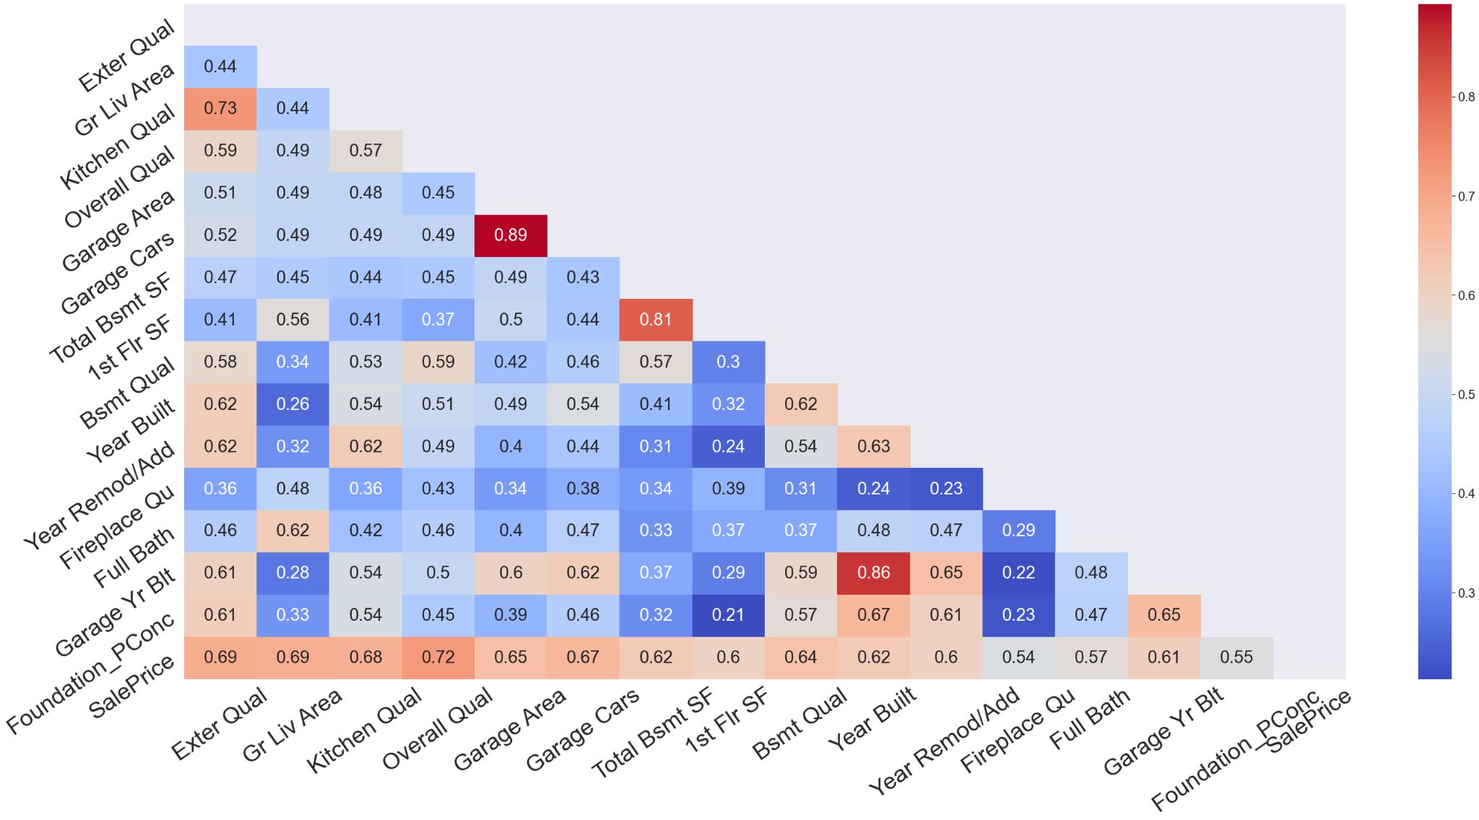
Heatmap representation
Highest pearson coefficient correlation to sales price, goes to Overall Quality,Ground Living Area and Kitchen quality.
From here, we can also see multicollinearity in some of the top features.
Garage area and garage cars
Total bsmt SF and 1st Flr SF
Year built and Garage year built

Slide 22
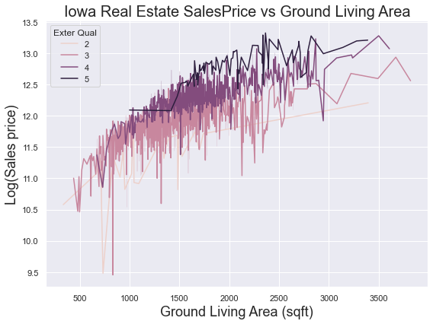
Correlation of Gr Living area/Overall Quality to Sales Price
From the lineplot, we can see an increasing trend for the log of salesprice as ground living area increases.
For every 1k sqft increase of living area, we expect prices to shoot up by $160,921
In fact, we can see on top of ground living area, external quality has a different baseline for saleprice.

Slide 23
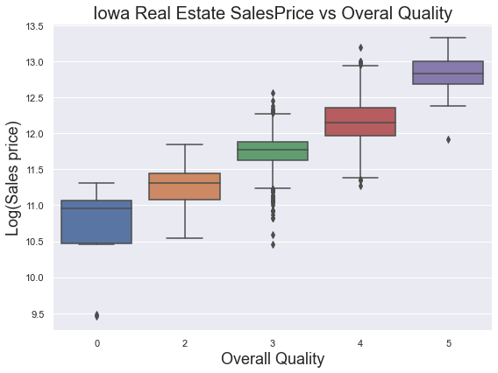
Correlation of Gr Living area/Overall Quality to Sales Price
The overall quality here rates the overall material and finish of the house.
We can see that from a 5 point scale of 1-poor to 5-excellent, the log sales price is moving towards a positive increasing trend.

Slide 24
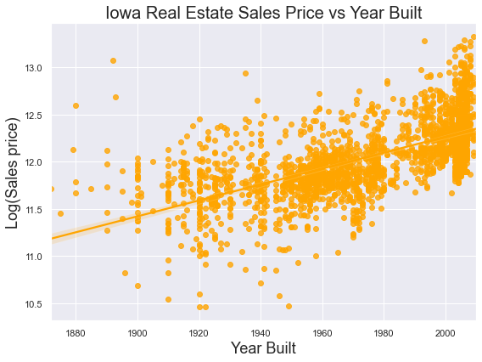
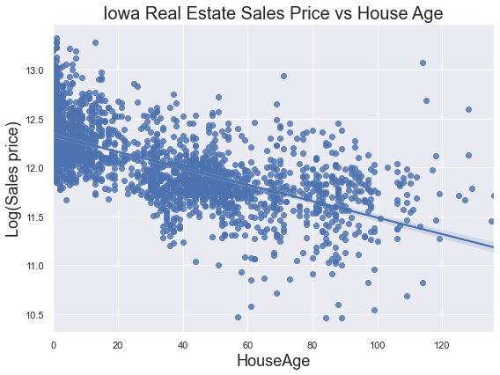
SalesPrice vs Year Built
Newer houses with higher built year also gets the highest sale prices.
This feature would add more value if we remodel it to the delta of the year sold & year built.

Slide 25
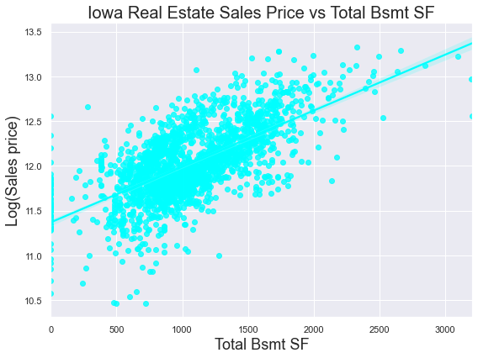
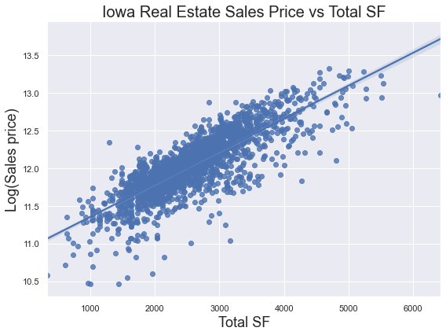
Sales Price vs Total Basement SF
We also see a positive correlation for Total Bsmt SF to Sale Price.
Since buyers don’t usually look at individual SF but total SF of the property.
Adding up all basement SF, 1st floor and 2nd floor will give us a bigger picture on the total SF.

Slide 26
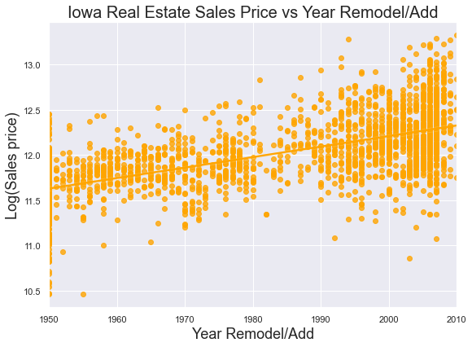
Sales Price vs Year Remodelled/Add
The year remodelled or added has a positive correlation to log of sales price.

Slide 27
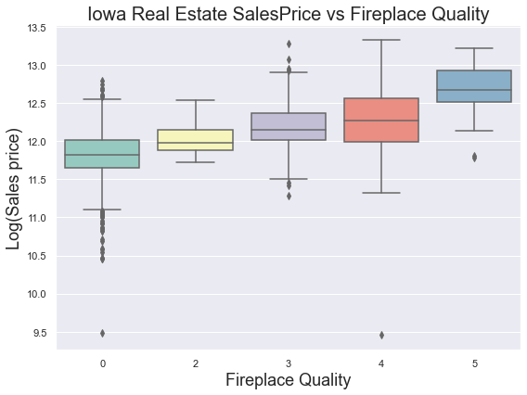
Sales Price vs Fireplace Quality
The data also suggests that fireplace quality have an influence on increasing the sales price of the property in Iowa

Slide 28
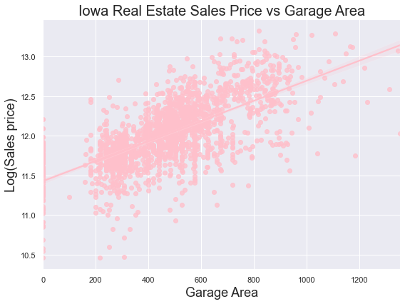
Sales Price vs Garage Area
The sales price also increases with increase of garage area which matches that of overall ground living area as well.

Slide 29
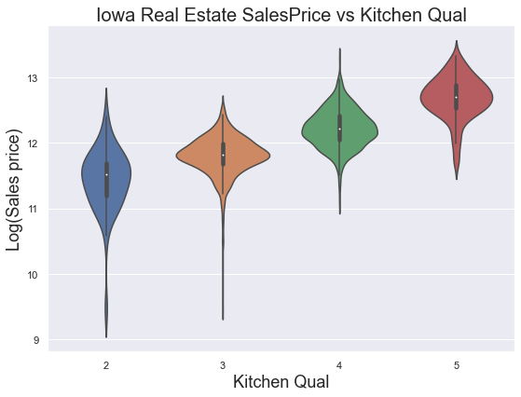
Sales price vs Kitchen quality
From the violinplot, we can see the requirement for better quality kitchen greatly increases the price of the real estate.

Slide 30
Model Selection
Models selection:
Linear Regression
Lasso Regression
Ridge Regression
ElasticNet

Slide 31
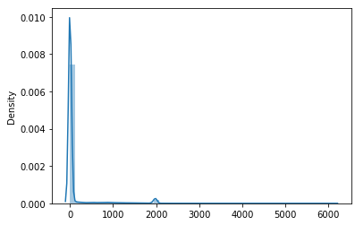
Scaling data (Before) - Standard Scaler
Distribution plot was plotted to represent data distribution.
Before scaling data

Slide 32
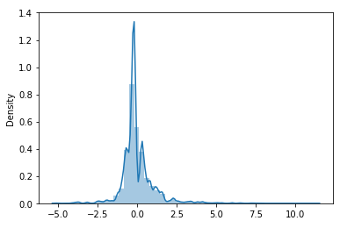
Scaling data (After) - Standard Scaler
Distribution plot was plotted to represent data distribution.
After scaling data
Normally distributed

Slide 33
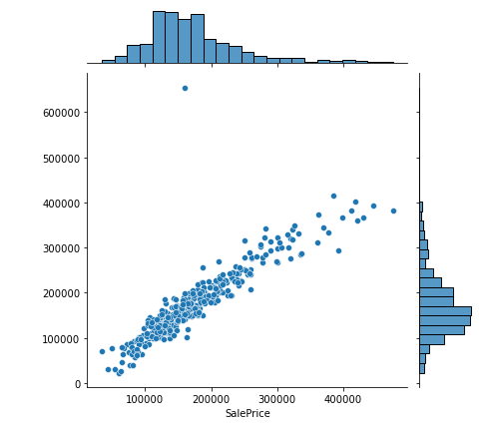
Ordinary Linear Regression
Using Ordinary Linear Regression,
Train score was 0.90
Test score was 0.79
This model showed evidence of overfitting.

Slide 34
Bias vs Variance - Avoiding overfitting
Regularization techniques were implemented to improve the model fit.
L1 Regularization
L2 Regularization
Lasso Regression
Ridge Regression

Slide 35
Lasso Regression
L1 Regularization

Slide 36
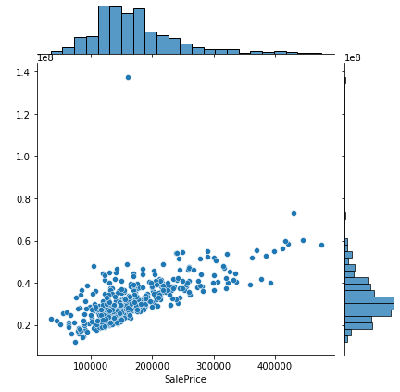
L1 Regularization
Lasso Regression
Lasso: y_test vs y_pred jointplot
L1 Regularization model was first used to attempt to penalize beta coefficients or zero them.
LassoCV was used to select the best parameters for a suitable bias-variance tradeoff.

Slide 37
L1 Regularization
Lasso Regression
Lasso: y_test vs y_pred jointplot
Scoring:
Lasso cross validation score (cv = 10) = 0.86
Lasso r2 test score = 0.77

Slide 38
Ridge Regression
L2 Regularization

Slide 39
L2 Regularization
Ridge Regression
Ridge: y_test vs y_pred jointplot
L2 Regularization model was used to appropriately weigh the model’s variables according to its importance.
RidgeCV was used to select the best parameters for a suitable bias-variance tradeoff.

Slide 40
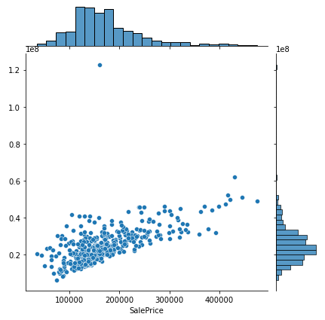
L2 Regularization
Ridge Regression
Ridge: y_test vs y_pred jointplot
Scoring:
Ridge cross validation score (cv = 10) = 0.86
Ridge r2 test score = 0.78

Slide 41
ElasticNet
L1 & L2 Regularization

Slide 42
L1 & L2 Regularization
ElasticNet Regression
ElasticNet: y_test vs y_pred jointplot
L1 & L2 Regularization model; Used 2 different regularization techniques to achieve a better score
ElasticNetCV was used to select the best parameters for a suitable bias-variance tradeoff.

Slide 43
L1 & L2 Regularization
ElasticNet Regression
ElasticNet: y_test vs y_pred jointplot
Scoring:
ElasticNet cross validation score (cv = 10) = 0.86
ElasticNet r2 test score = 0.61

Slide 44
Residuals Plot - Detecting outliers and abnormalities

Slide 45
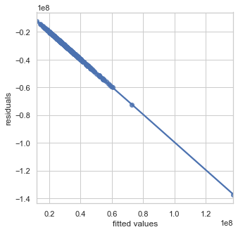
Lasso Residuals Plot
Residuals Plot
Lasso: Residuals vs Fitted values
Lasso
y_pred vs (y_test - y_pred)
No abnormalities detected in the chart.
Equal distributed residuals

Slide 46
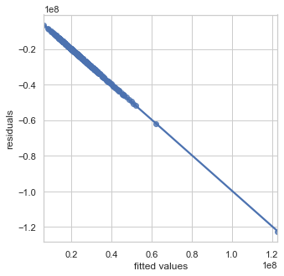
Ridge Residuals Plot
Residuals Plot
Ridge: Residuals vs Fitted values
Ridge
y_pred vs (y_test - y_pred)
No abnormalities detected in the chart.
Equal distributed residuals

Slide 47

ElasticNet Residuals Plot
Residuals Plot
ElasticNet: Residuals vs Fitted values
ElasticNet
y_pred vs (y_test - y_pred)
No abnormalities detected in the chart.
Equal distributed residuals

Slide 48
Histogram of Residuals Plot - Detecting magnitude of outliers

Slide 49
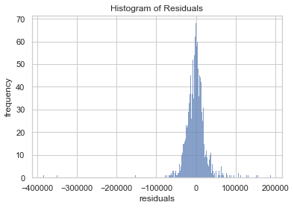
Lasso Histogram of Residuals
Histogram of Residuals
Lasso:
Lasso
Low frequency of outliers of up to of:
-400,000 and +200,000
Histogram shows residuals normally distributed around 0.

Slide 50

Ridge Histogram of Residuals
Histogram of Residuals
Ridge:
Ridge
Low frequency of outliers of up to of:
-400,000 and +200,000
Histogram shows residuals normally distributed around 0.

Slide 51

ElasticNet Histogram of Residuals
Histogram of Residuals
ElasticNet:
ElasticNet
Low frequency of outliers of up to of:
-400,000 and +200,000
Histogram shows residuals normally distributed around 0.

Slide 52
Model Selection for final sales price prediction

Slide 53
Model Selection - Ridge Regression
Lasso cross validation score = 0.8606
Lasso R2 test score = 0.771
Ridge cross validation score = 0.8601
Ridge R2 test score = 0.787
ElasticNet cross validation score = 0.8606
ElasticNet R2 test score = 0.612
Hence, Ridge Regression was selected as it had comparable cross validation score & a higher R2 score than other models.

Slide 54
Conclusion

Slide 55

Conclusion
Best features that affect house sale price
Quality
Year Built
Area
Quality

Slide 56

Recommendation for house owner
Ways to retain housing value:
Maintain quality of the house.
Schedule maintenance such as:
Repaint the house every 5 - 10 years.
Spring cleaning.
Use quality furnishing.
Remodel the house.
No strong correlation features :
Swimming pool
Porch
Misc Value
Month Sold

Slide 57
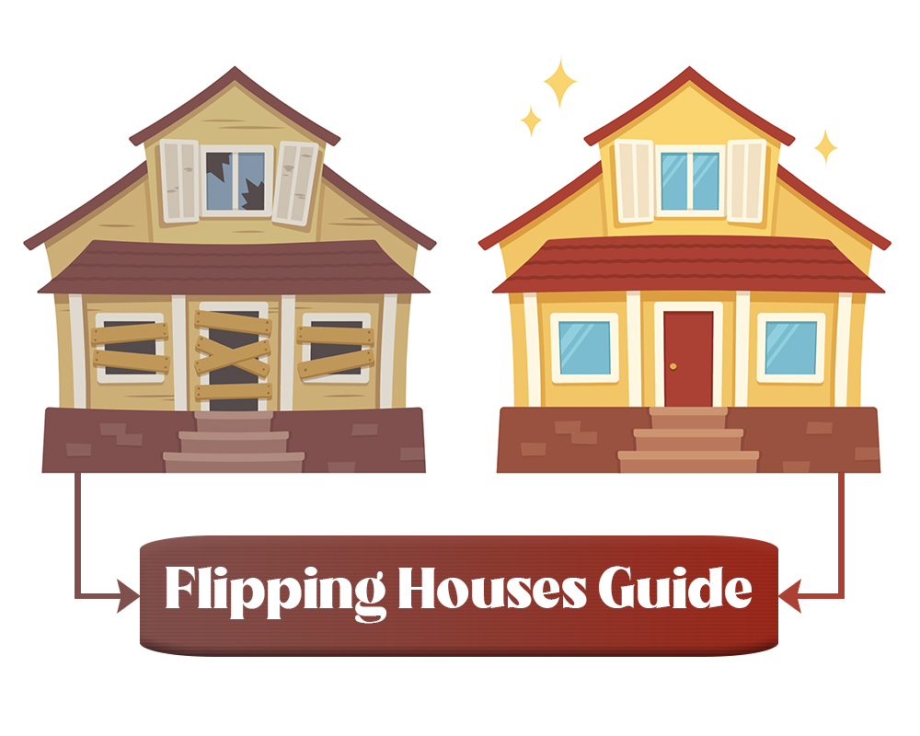


Recommendation for investors
House Flipping
Buy low quality houses at lower price
Renovation
Re-sell the house at higher value.
Profit

Slide 58
Housing Price analysis model
Ridge regression model.
Ridge is suited the best for the housing price prediction.
Highest R2 score = 0.787.
Most suitable to be used at the same district or city area.

Slide 59
Model Improvement
Effective/Weighted age of the property.
The effective age is calculated by taking the percentage of the remodeling or modernization in relation to the whole.
For example:
70% house structure = 50 years,
25% house structure = 10 years
5% house structure = 5 years.
Effective age = 0.7*50 + 0.25*10 + 0.5*5 = 40 years
Data required:
Percentage of remodelling.
Area remodelled.

Slide 60
References
Sources:
https://www.santacruzcountyaz.gov/208/Effective-Weighted-Age#:~:text=The%20effective%20age%20is%20calculated,0.50%20X%2040%20%3D%2020.0%20years
https://www.investopedia.com/articles/mortages-real-estate/11/factors-affecting-real-estate-market.asp
https://www.newrez.com/blog/home-buying-selling/5-things-that-influence-home-prices-in-2021/
https://www.investopedia.com/articles/mortages-real-estate/11/the-truth-about-the-real-estate-market.asp
https://www.whitehouse.gov/cea/written-materials/2021/09/09/housing-prices-and-inflation/
https://www.americanactionforum.org/insight/understanding-the-national-increase-in-house-prices/
https://www.opendoor.com/w/blog/factors-that-influence-home-value

